Slide 1
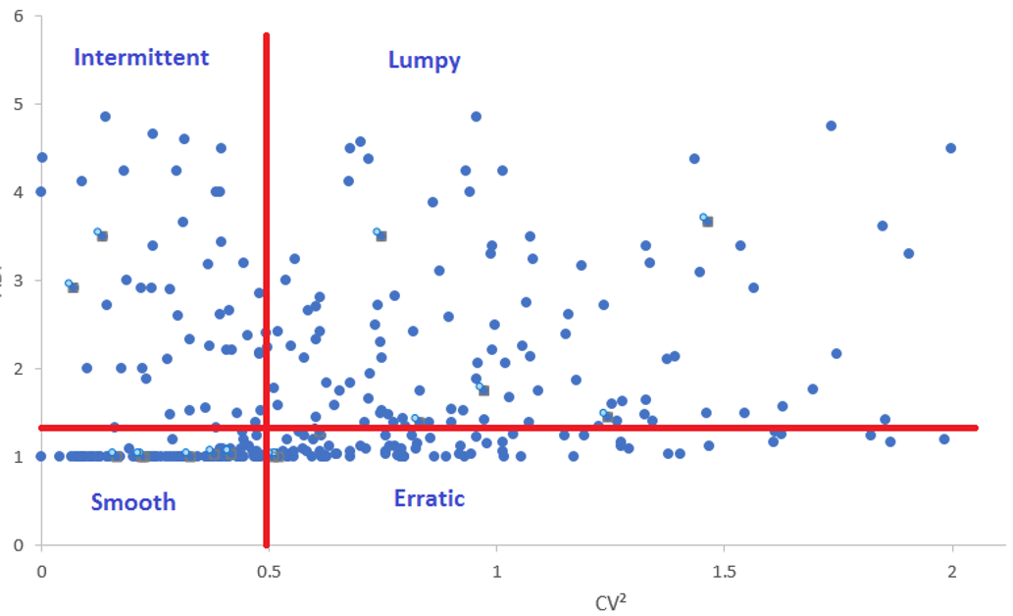
Intermittent Demand Classification Using Machine Learning
Guide:
Dr. J.B.Simha
By:
Ashish K. Singh

Slide 2
Agenda
Problem Statement
Introduction
Business Understanding
Data Understanding
Data Preparation
Modeling
Evaluation

Slide 3
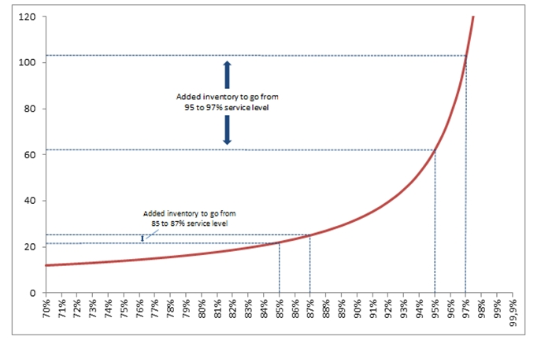
Problem Statement
Increasing the service level (probability of not losing sales) from 95 to 97% is vastly more expensive than increasing it from 85 to 87%.
Inventory carrying costs is expressed as a percentage number and typically accounts for 15% to 30% of the value of a merchant’s inventory.
Intermittent demand components constitute up to 60% of this total stock.

Slide 4
Introduction

Slide 5
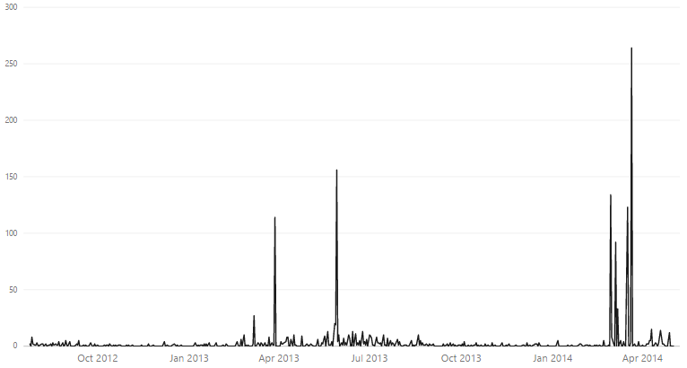
What is Intermittent Demand? (also known as Sporadic demand)
Defined as “infrequent in the sense that the average time between consecutive transactions is considerably larger than the unit time period”
When a product experiences several periods of zero demand.
Often demand is small, and sometimes highly variable in size.
Very common in industries such as aviation, automotive, defence, manufacturing and retail.
Also seen for products nearing end of their life cycle.

Slide 6
Intermittent Demand Forecasting Techniques
Forecasting Techniques
Qualitative techniques
Quantitative techniques
Delphi method
Time Series Analysis
Causal Forecasting
Market Research method
X11 Forecasting
ARIMA (Autoregressive integrated moving average)
Econometric Model
Panel Consensus
Moving Average (MA)
Regression
Bayesian decision theory
Leading Indicator Models
Exponential Smoothing (EA)

Slide 7
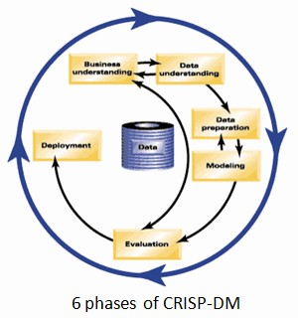
Project Methodology
Cross Industry Standard Process for Data Mining or CRISP-DM is a 1996 methodology created to shape Data Mining projects. It consists of 6 steps to conceive a Data Mining project and they can have cycle iterations according to developers’ needs. These steps are
Business Understanding
Data Understanding
Data Preparation
Modeling
Evaluation, and
Deployment.

Slide 8
Business Understanding

Slide 9
“Inventory is a current asset that should more than earn its keep; if inventory incurs more costs than benefits, it is really a liability. Excess inventory is clearly an operational liability.” (Toelle & Tersine, 1989).

Slide 10
Problems with Current Methods
Due to peculiar characteristics of intermittent demand, traditional forecasting methods perform poorly.
Traditional methods assume demand to be stationary where intermittent demand data is not stationary.
Traditional technologies ignore the special role of zero values when analyzing demand and tend to simply “smooth over” the zero and occasional non-zero values found in intermittent data.
Understanding if the product has structural zeros or intermittent zeros. Structural zeros have a noticeable data pattern whereas intermittent zeros occur randomly.

Slide 11
Impact of Demand Forecasting
Optimized Inventory:
Maintaining lower End of day (EOD) inventory on Average.
Having a dynamic Re-order point (ROP)*, based on forecasted lead time demand.
Reduced Demand Uncertainties:
Lesser number of stock-out days.
Better understanding of customer needs.
Cost Savings:
More profitable linking of pricing, promotions & other sales incentives.
More efficient & predictable use of plant capacity, equipment and labor.

Slide 12
Data Understanding

Slide 13
Intermittent Demand Data
Column | Type | Explanation
dayOfWeek | Numeric | The day of the week on which the sale is made
promo | Numeric | % of discount on the day of sale
marketing | Boolean | Marketing campaign performed or not
Sales | Numeric | Sale made on the day

Slide 14
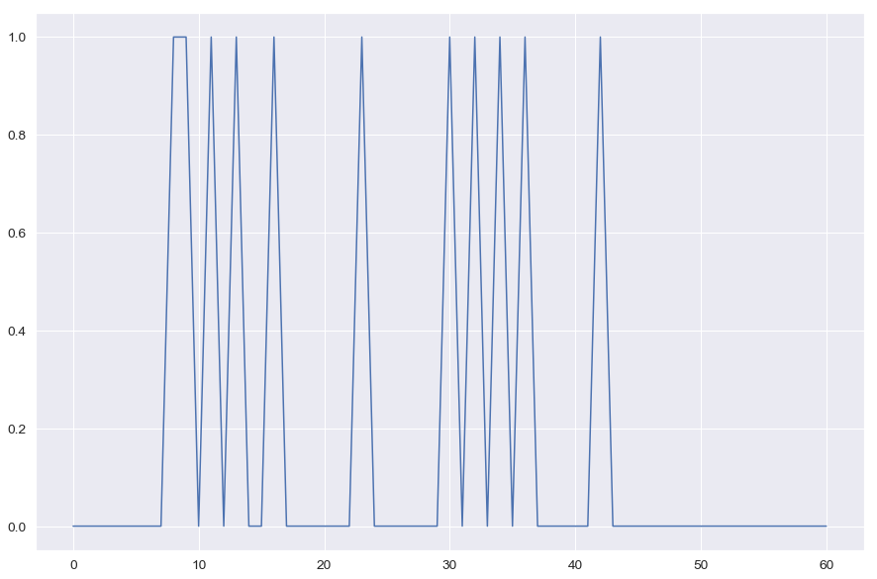
Demand Pattern
dayOfWeek | Cumulative Sales
1 | 0
2 | 2
3 | 0
4 | 2
5 | 1
6 | 0
7 | 4
Total | 9

Slide 15
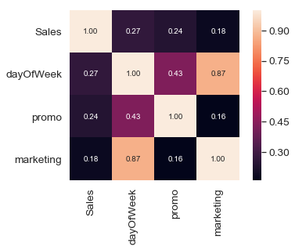
Co-Relation Matrix

Slide 16
Data Preparation

Slide 17
Feature Engineering
Rolling window :- A rolling window with window size of 7 days was created
Lag :- 7 lags of the demand were created (lag1 = Dt-1, lag 2 = Dt-2, lag 3 = Dt-3...and so on)
Zero Cumulative :- The number of time periods since the last period where non-zero demand occurs
Rolling Mean :- Average for a window of data for 3 and 6 periods
Demand Days: - Cumulative sum of demand rolling window of 7 days.
No Demand Days :- 7 - Demand Days

Slide 18
Modeling

Slide 19
Modeling technique
A 80-20 test train split was performed on the dataset.
3 different Machine Learning techniques were chosen for modeling:-
Naive Bayes
Support Vector Classifier
Neural Network – MLP
2 models were created for each of the above techniques, one without feature engineering and another with feature engineering and results were compared.

Slide 20
Evaluation

Slide 21
Accuracy
 | Naive Bayes | Support Vector Classifier | Neural Network – MLP
Without Feature Engineering | 76.9% | 92.3% | 92.3%
With Feature Engineering | 92.3% | 100% | 84.6%

Slide 22
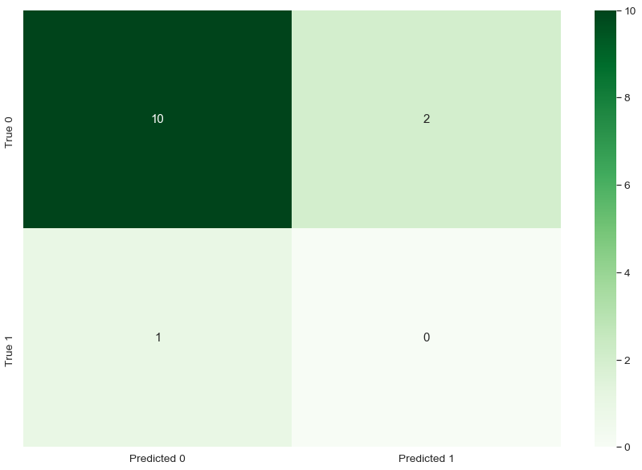
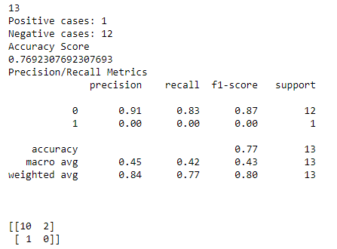
Naive Bayes- Without Feature Engineering

Slide 23
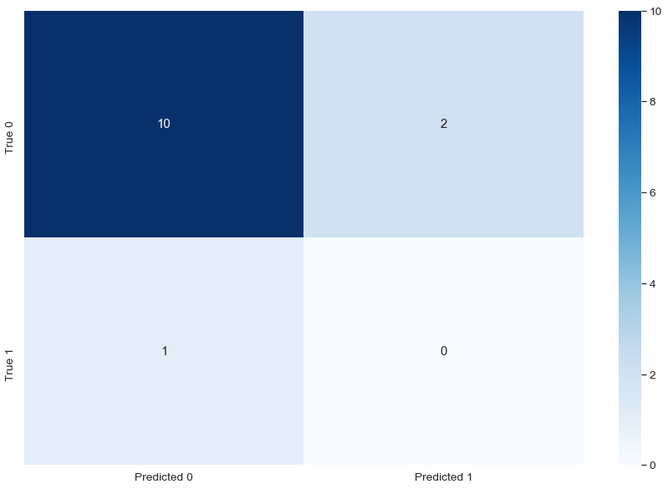
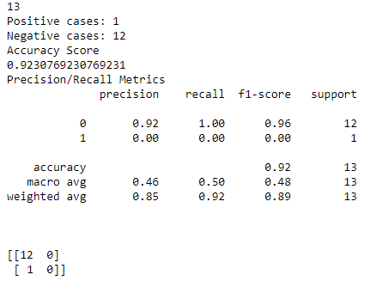
Support Vector Classifier- Without Feature Engineering

Slide 24
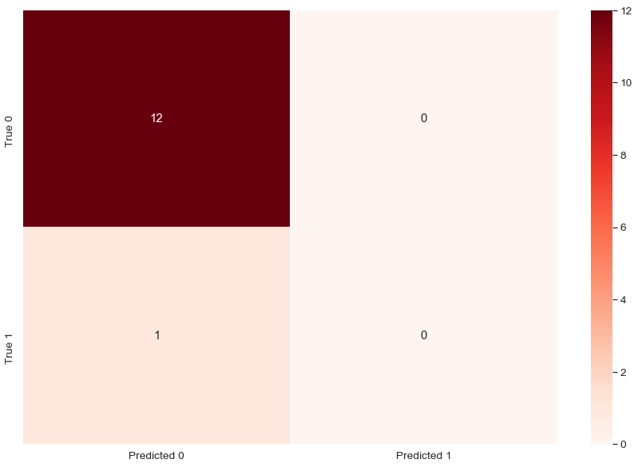
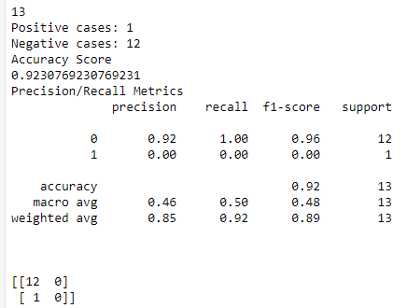
Neural Network – MLP - Without Feature Engineering

Slide 25
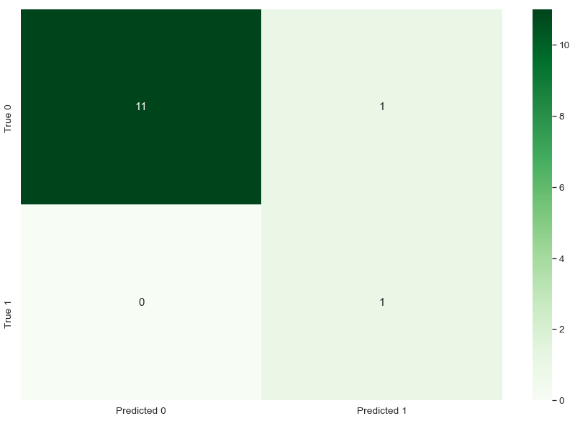
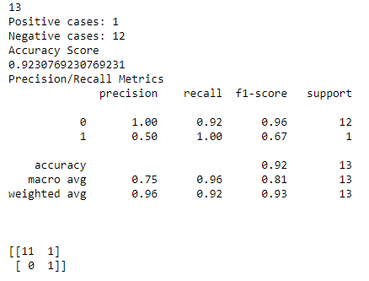
Naive Bayes- With Feature Engineering

Slide 26
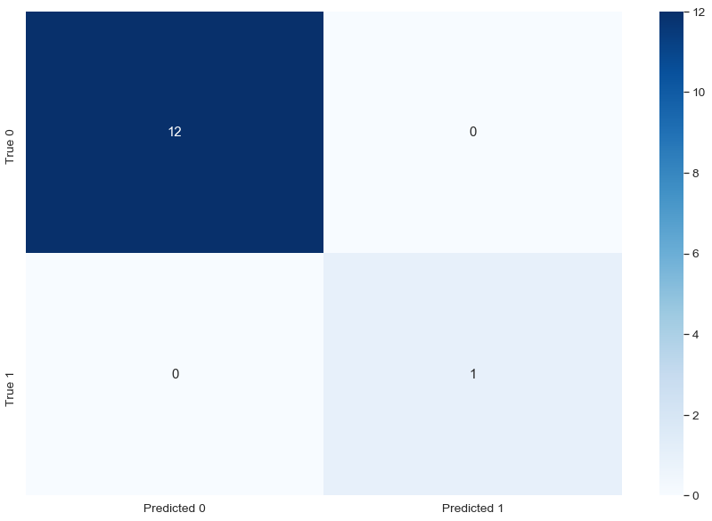
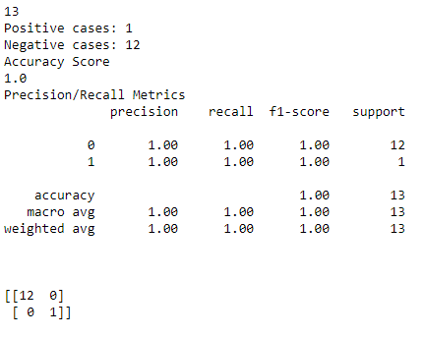
Support Vector Classifier- With Feature Engineering

Slide 27
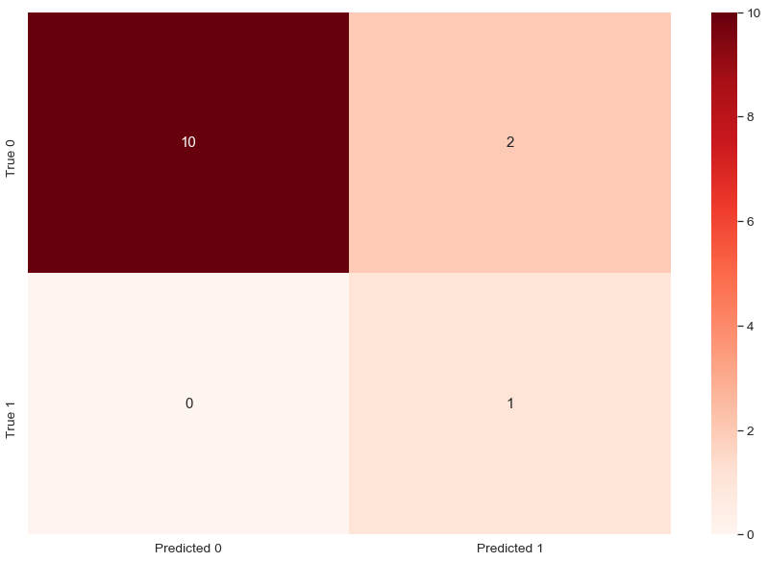
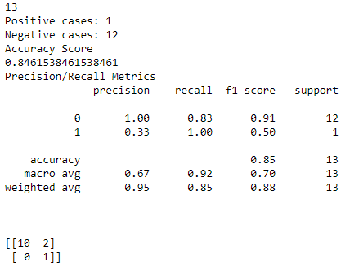
Neural Network – MLP – With Feature Engineering

Slide 28
Deployment

Slide 29
Current Status
This Model has not yet been deployed and is currently being adapted to validate on a larger set of validation dataset to predict the classification of Intermittent demand components forecast for a large aerospace OEM engaged in designing, manufacturing and servicing, systems and components for commercial aviation, business aviation, helicopters, military & defence sector, space, airports and several other industries in Road Transport, Marine and Critical Infrastructure.

Slide 30
THANK YOU
By:-
Ashish K. Singh
BA05

